Slide 1
Perspective of data science Project
Team Flash[Group-12]
Dileep P
Abhishek Y
Rajesh Y
Vineeth I
Suraj G

Slide 2


Agenda
Problem Statement
Data Cleaning
EDA
Feature selection
Model Development
AUC & ROC
Measuring model performance
Testing the Model

Slide 3

Problem Statement
In this project we have decided to implement a classification model on the given data set to predict the gender of the person using selected features.
Features we have chosen
Height
Weight
Age
Marital status
Number of shopping trips a month

Slide 4

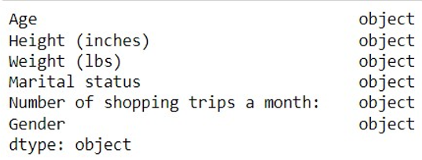
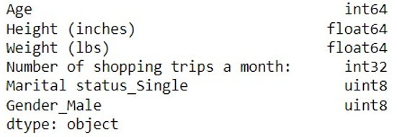
Data cleaning
Data Cleaning is the process of identifying the incorrect, incomplete, inaccurate, irrelevant or missing part of the data and then modifying, replacing or deleting them according to the necessity.
We performed Data cleaning by removing all the null values, created dummies for Gender and marital status.
We have formatted the selected features into the respective units and type conversions.

Slide 5
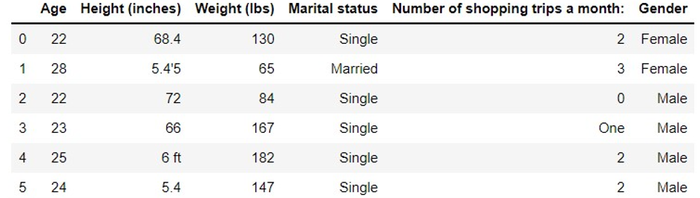
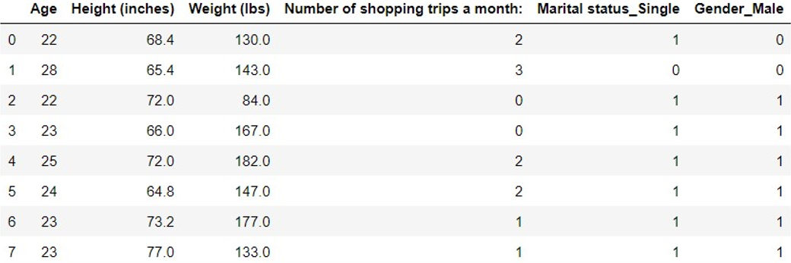
Data cleaning

Slide 6
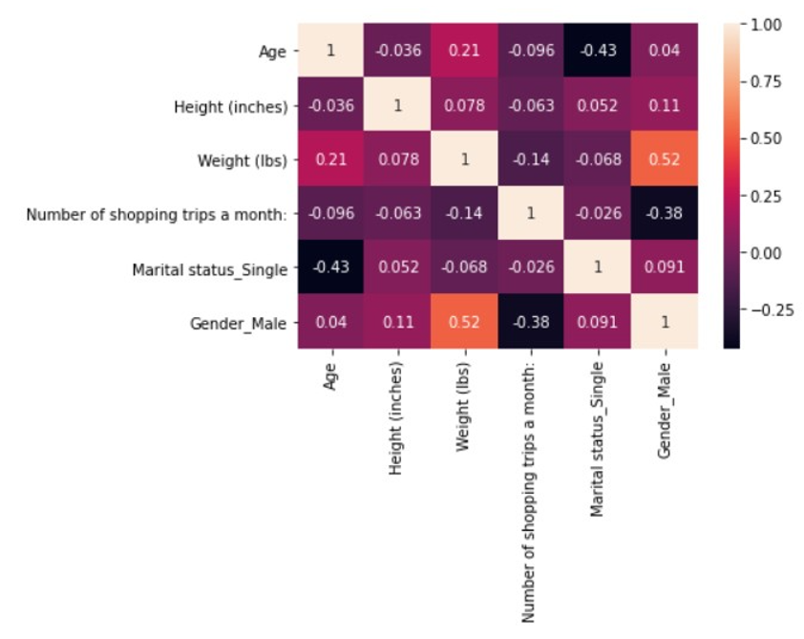
Exploratory data analysis
Exploratory Data Analysis is an approach to discover trends, patterns, or to check assumptions with the help of statistical summary and graphical representations.

Slide 7
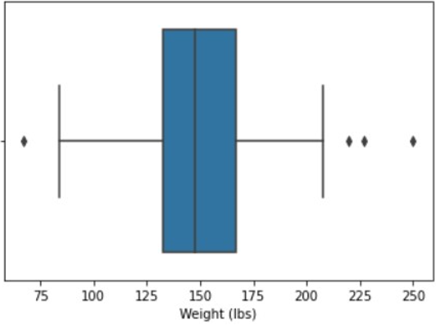
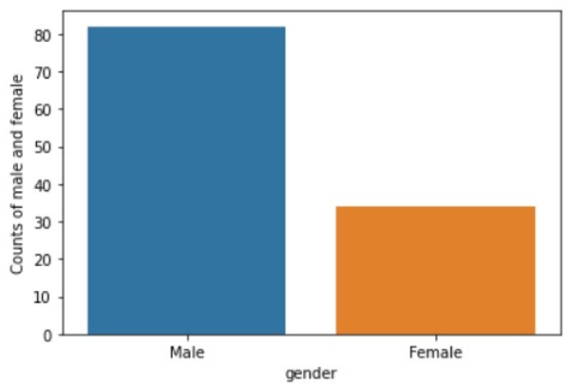
Exploratory data analysis

Slide 8
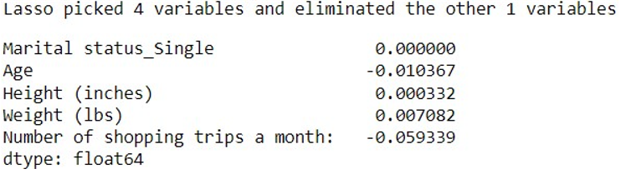
Feature selection
We have used LASSO Regularization(L1) from the available feature selection techniques.
After performing the LASSO out of 5 features it deducted one and settled with four features.

Slide 9
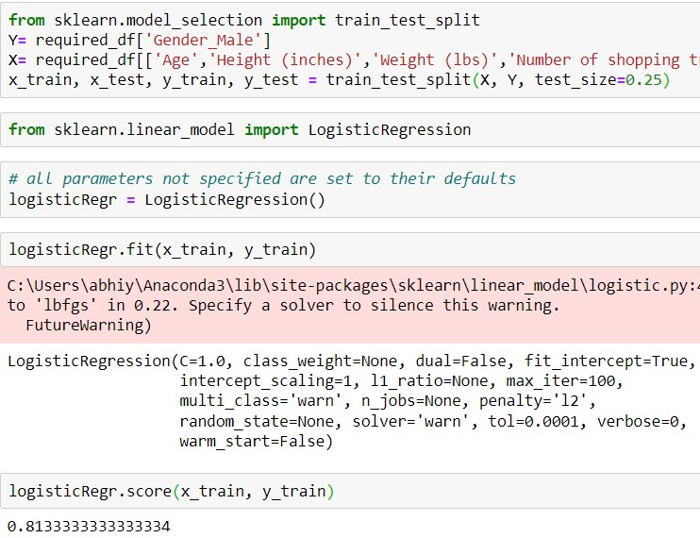
Model development
Logistic regression is a calculation used to predict a binary outcome: either something happens or does not.
Independent variables are analyzed to determine the binary outcome with the results falling into one of two categories. The independent variables can be categorical or numeric, but the dependent variable is always categorical.

Slide 10

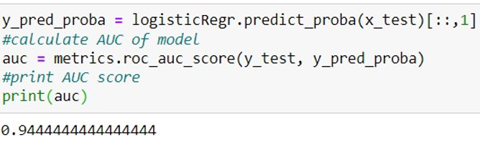
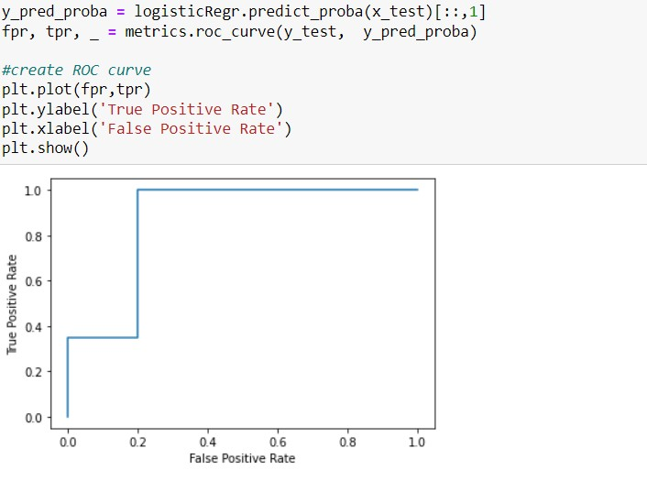
AUC & ROC
AUC(AREA UNDER COVER)
AUC score measures the total area underneath the roc curve.
AUC:0.5<AUC<1, there is a high chance that the classifier will be able to distinguish the positive class values from the negative class values.
ROC stands for Receiver Operating Characteristics. It is a graph of True Positive Rate (TPR) vs False Positive Rate(FPR) (separates the ‘signal’ from the ‘noise’). 1. TPR means recall. 2. FPR is the ratio of Negative classes inaccurately being classified as positive.TPR=TP/(TP+FN) FPR = FP/(FP+TN)
ROC(RECEVER OPERATING CHARACTERSTIC)

Slide 11
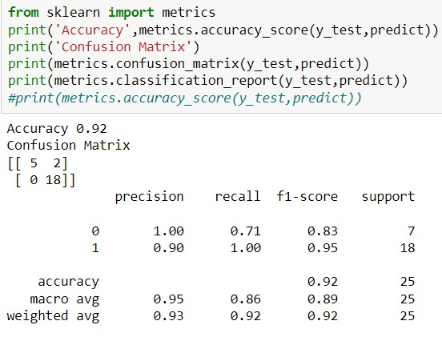
Measuring model performance

Slide 12
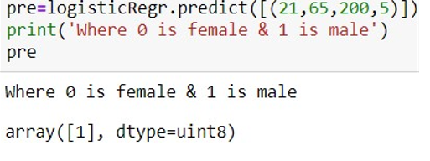
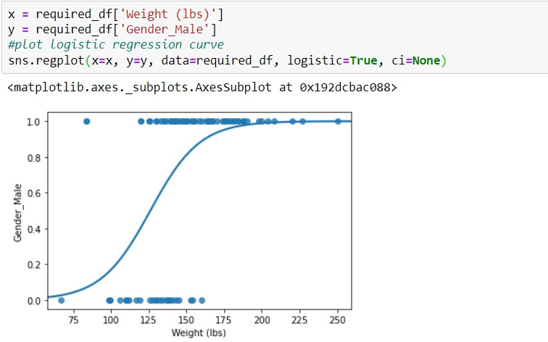
Testing the Model
Here we are testing the model by passing the Features into the model as shown in the snippet
We are passing Age, Height, Weight and Number of shopping trips per month as params to the model and the model predicts the Gender based on the input values.

Slide 13


Thank you

